Slide 1
The Common Neural Currency Hypothesis
Gregory Berns
Center for Neuropolicy, Emory University

Slide 2


vs.
?

Slide 3
Outline
Utility
Dopamine
fMRI correlates of goods
fMRI correlates of bads
Summary & future work

Slide 4
Utility
“By the principle of utility is meant that principle which approves or disapproves of every action whatsoever, according to the tendency which it appears to have to augment or diminish the happiness of the party whose interest is in question…”
“By utility is meant that property in any object, whereby it tends to produce benefit, advantage, pleasure, good, or happiness … or to prevent the happening of mischief, pain, evil, or unhappiness….”
-Jeremy Bentham, “The Principles of Morals and Legislation”, 1780

Slide 5
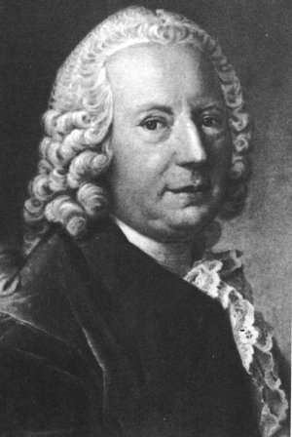
Diminishing Marginal Returns
(Daniel Bernoulli, 1738)
Utility
Value

Slide 6
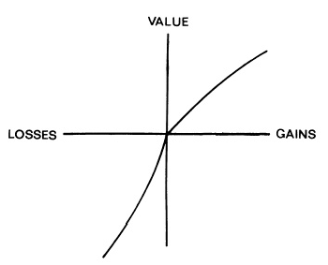
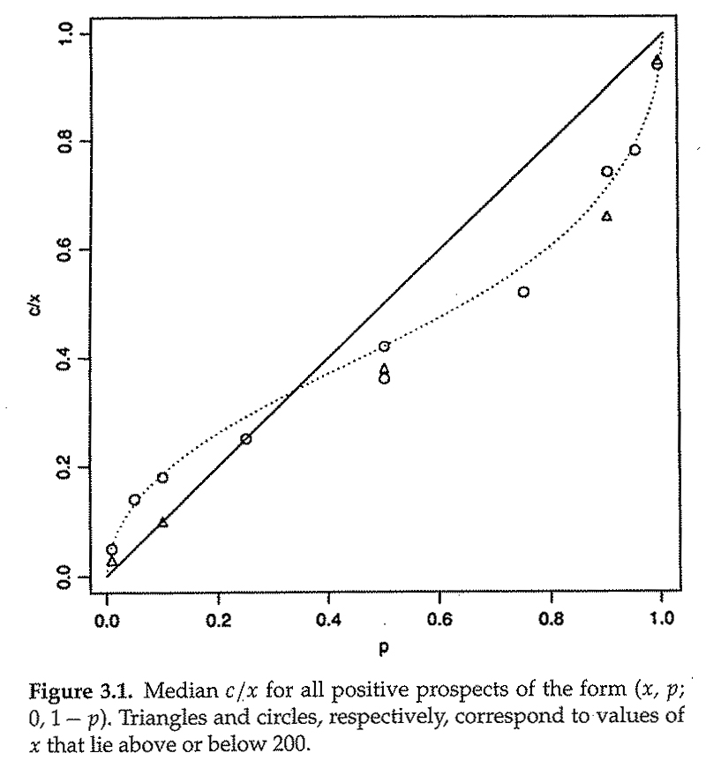
Prospect Theory

Slide 7
A Fable of Dopamine

Slide 8
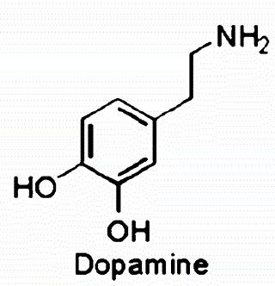
Pleasure Chemicals

Slide 9
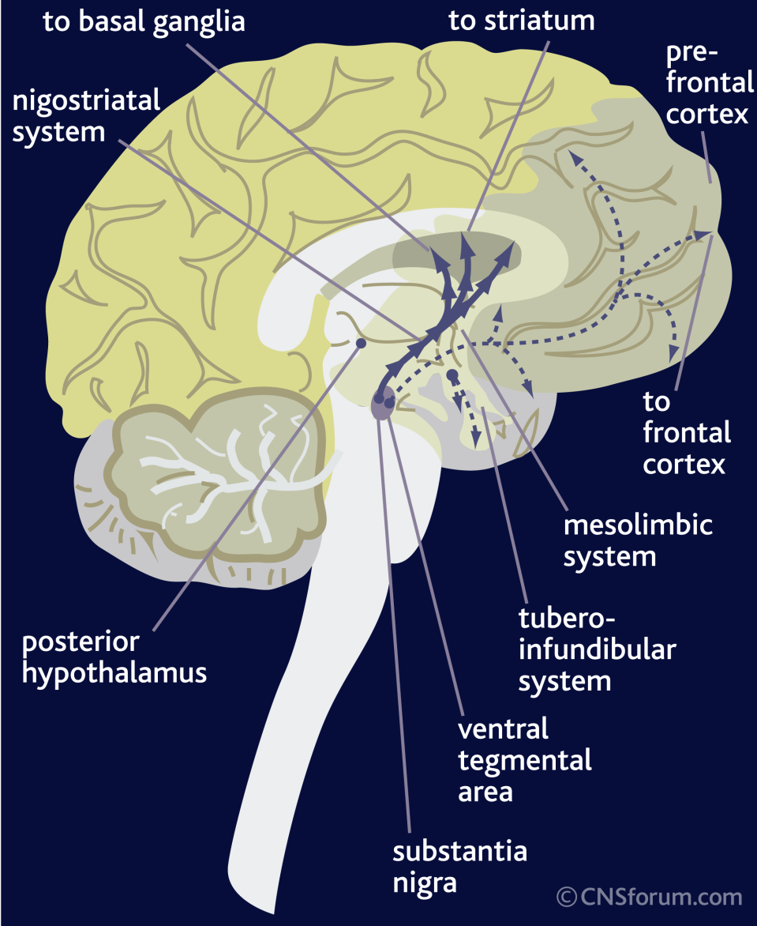
Dopamine Pathways

Slide 10
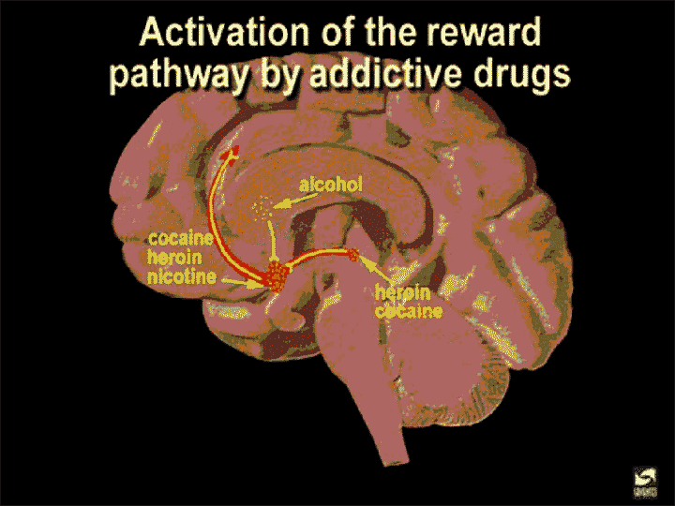
Dopamine and Drugs

Slide 11
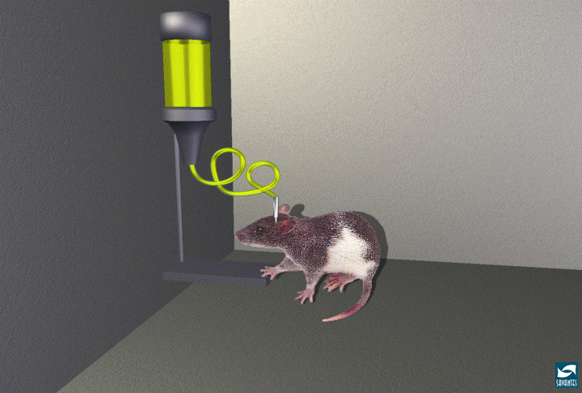
Dopamine Feels Good

Slide 12
The Modern Story of Dopamine

Slide 13
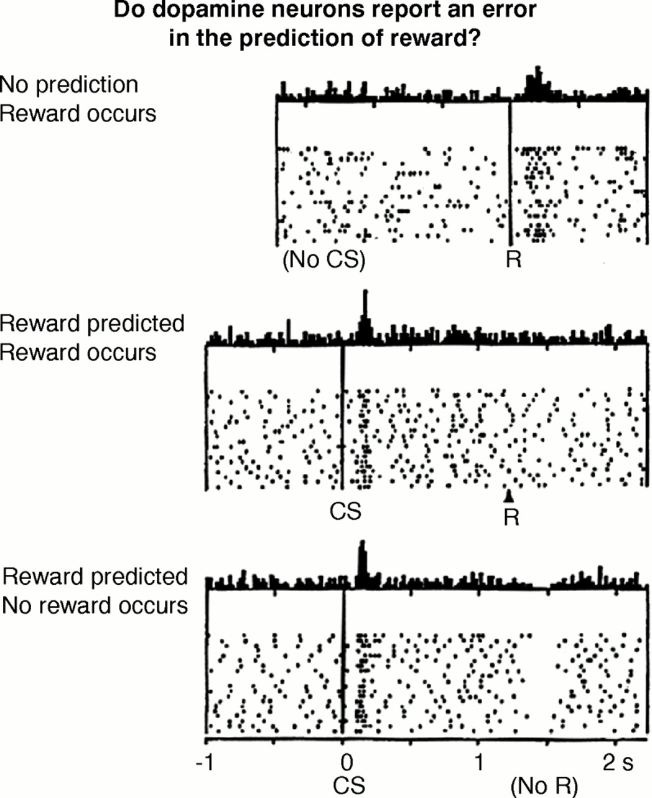
Dopamine and Reward Expectancies
Schultz, 1992

Slide 14
Dopamine ≠ Pleasure
Dopamine = Anticipation

Slide 15
Receptor Occupancy Theory
A + R ↔ AR → Stimulus → Response

Slide 16
fMRI of Goods

Slide 17
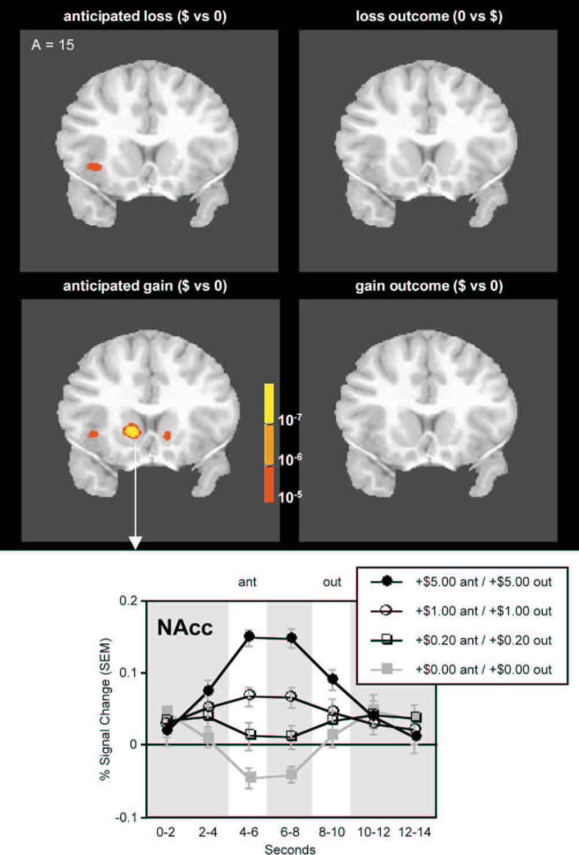
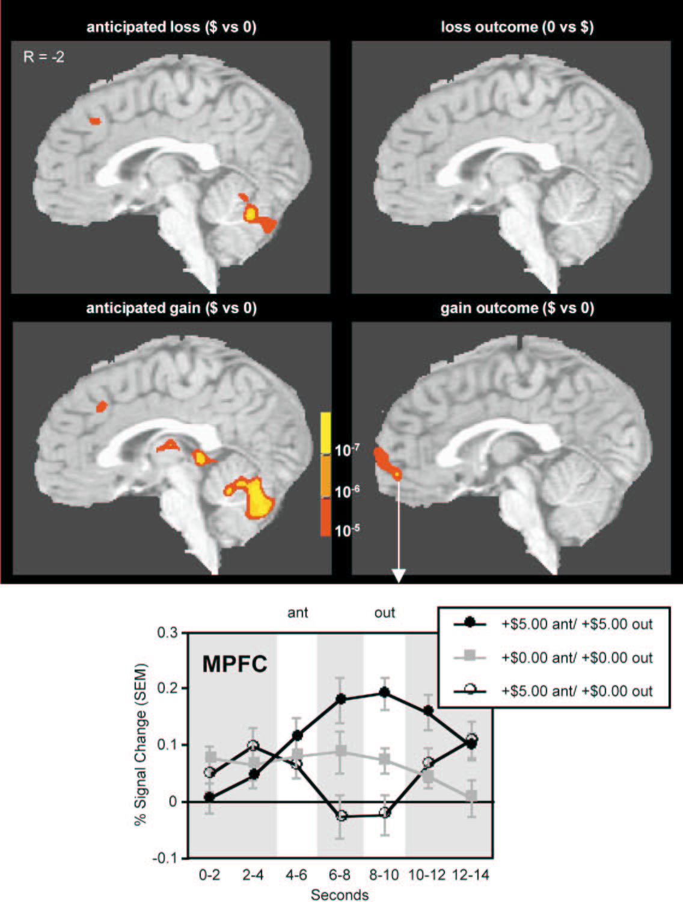
Monetary Value
ANTICIPATION
GAIN
Knutson et al, 2003

Slide 18
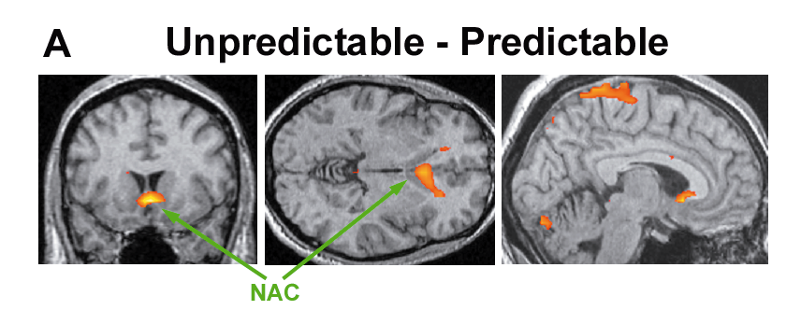
Predicted v. Unpredicted Tastes
Berns et al., J Neurosci 2001

Slide 19
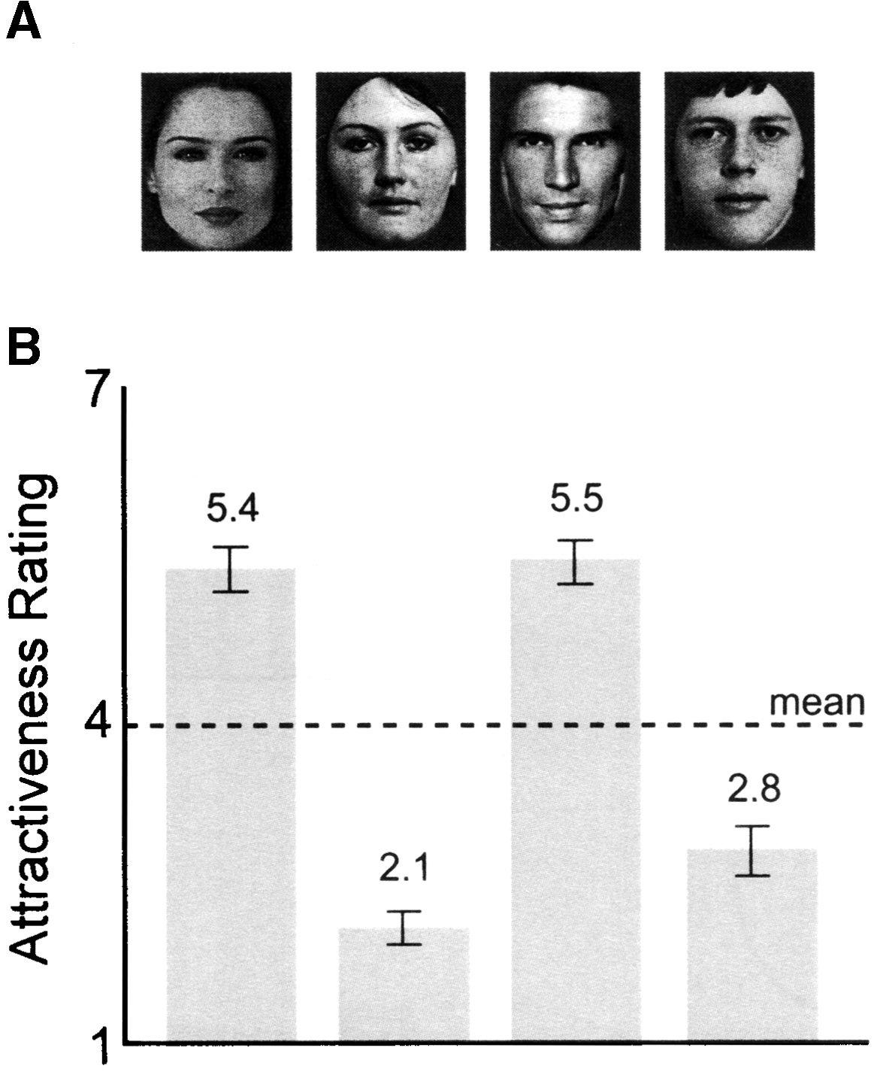
Beautiful Faces
Aharon et al, Neuron 2001.

Slide 20
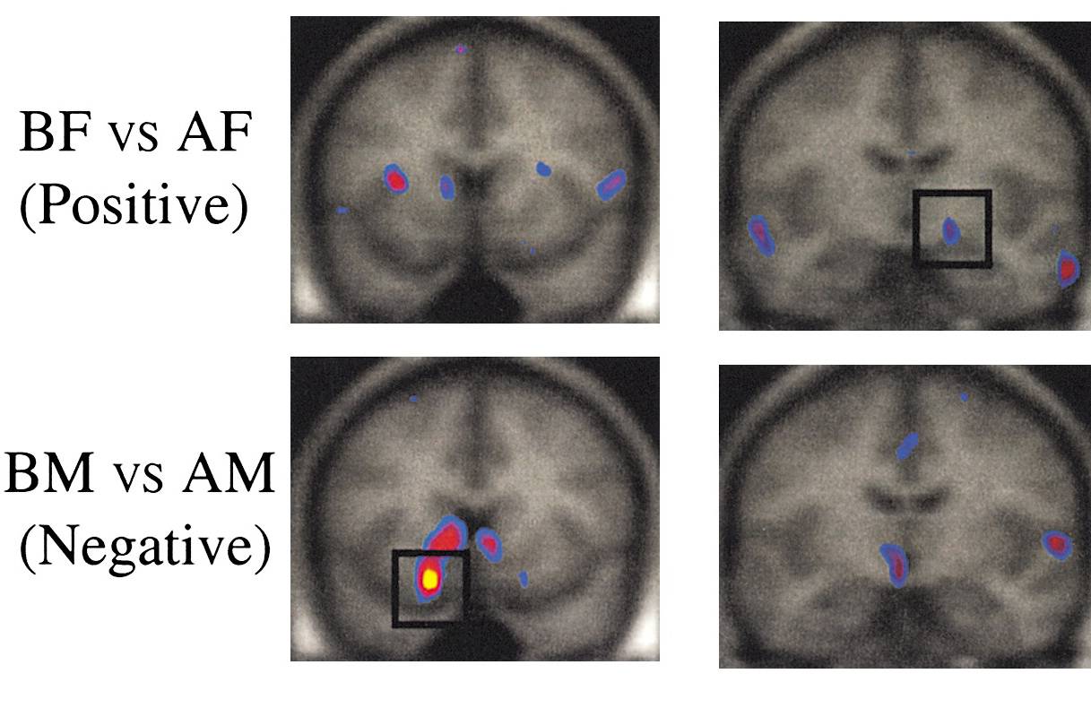
Beautiful Results

Slide 21
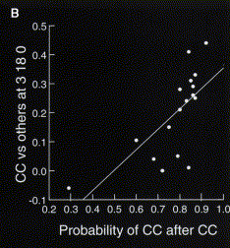
Mutual Cooperation vs Other Outcomes
caudate/septum/
Nac/AC
OFC
Rilling et al., 2002

Slide 22
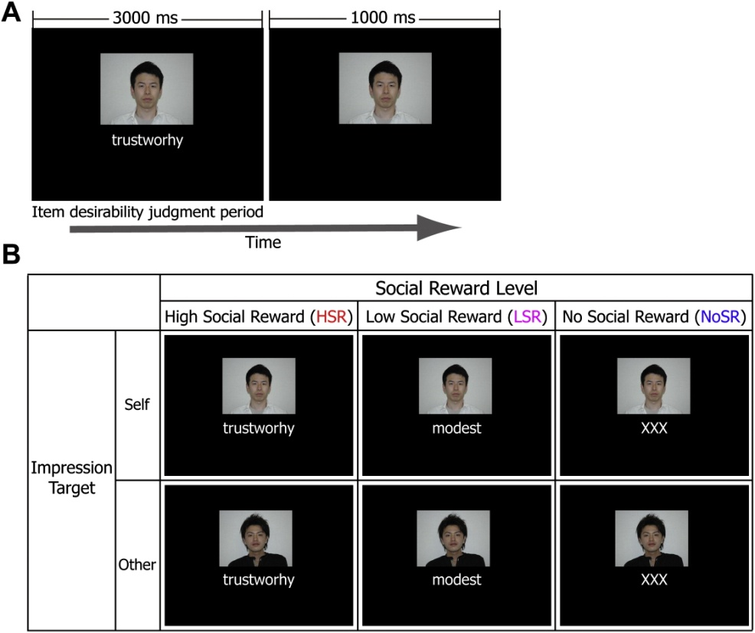
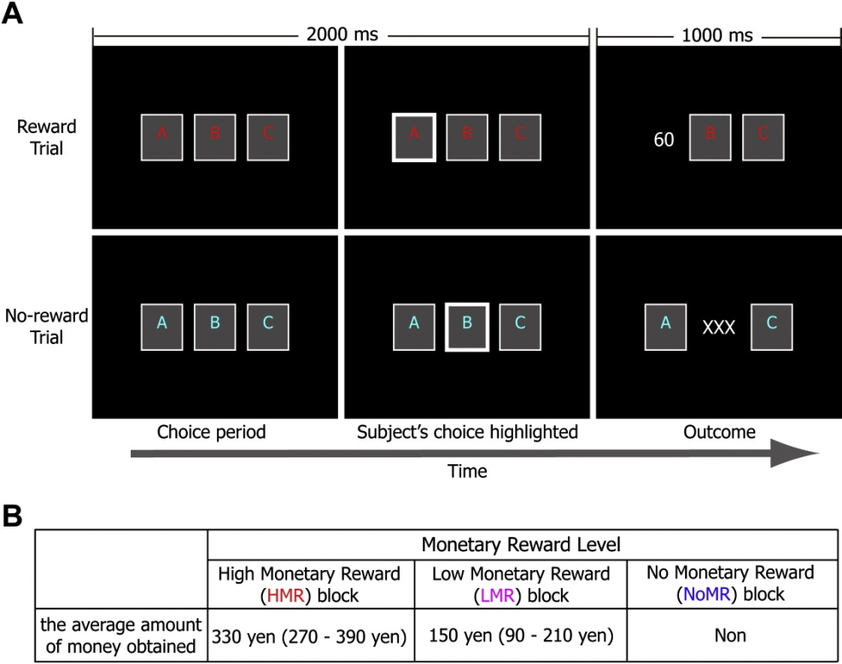
Monetary vs. Social Reward
Izuma, Saito & Sadato, Neuron, 2008

Slide 23
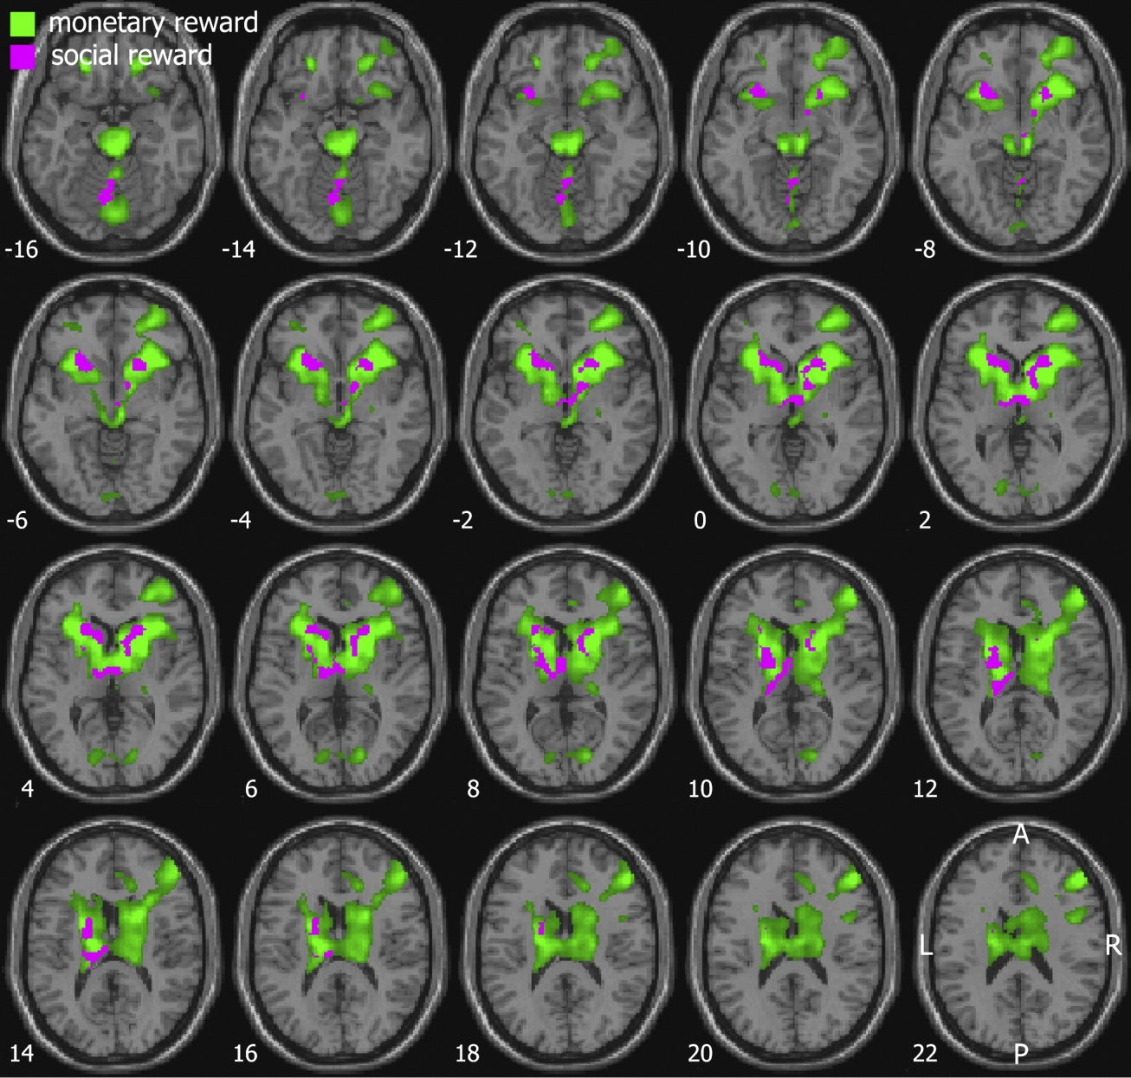
Monetary vs. Social Reward

Slide 24
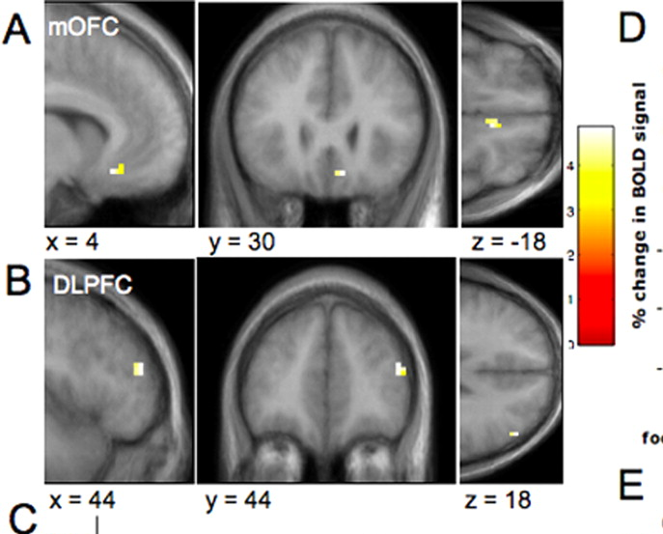
Decision Utility (WTP)
Plassmann et al., J Neurosci 2007

Slide 25
fMRI of Bads

Slide 26
What is Pain?
Intensity of stimulation
  Physical sensation
  Recruitment of pain sensors (nociception)
Attention to body part
Visceral response
Emotional response
Anticipatory response

Slide 27
Pain Matrix
Craig, 2003

Slide 28
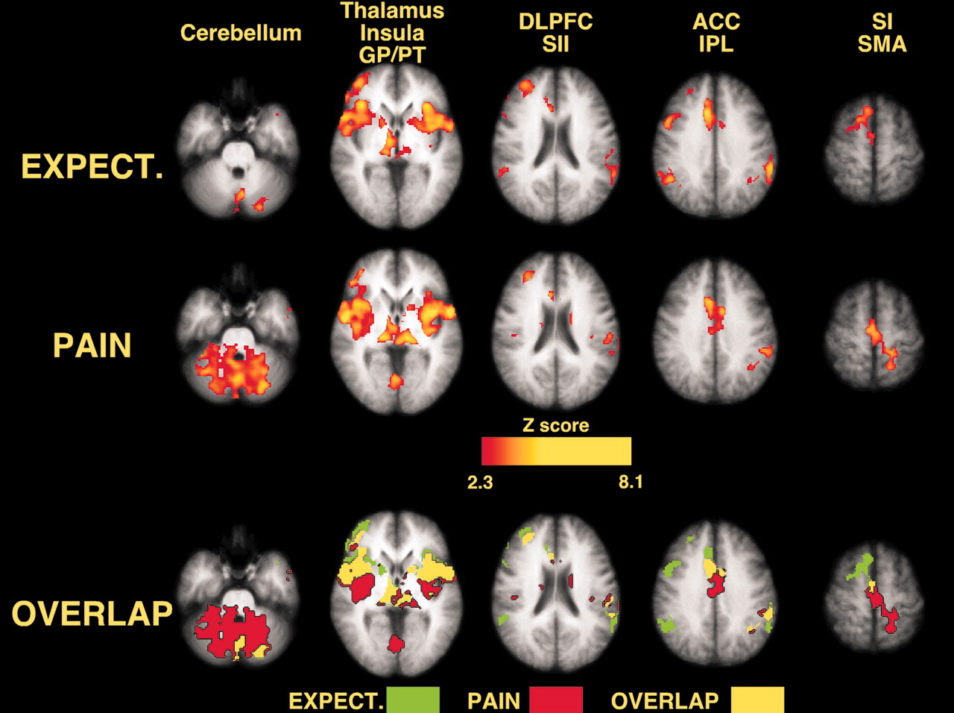
Anticipation of Pain
Koyama et al., 2005

Slide 29
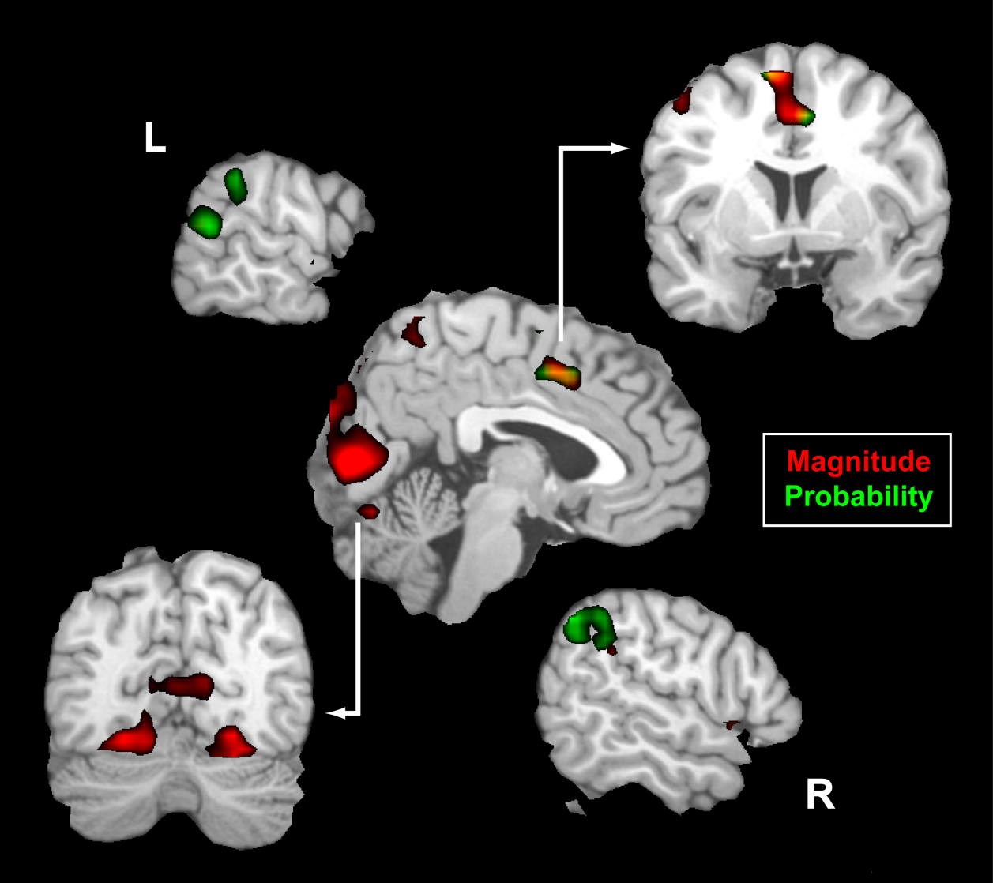
Effects of Expected Pain Magnitude & Probability

Slide 30
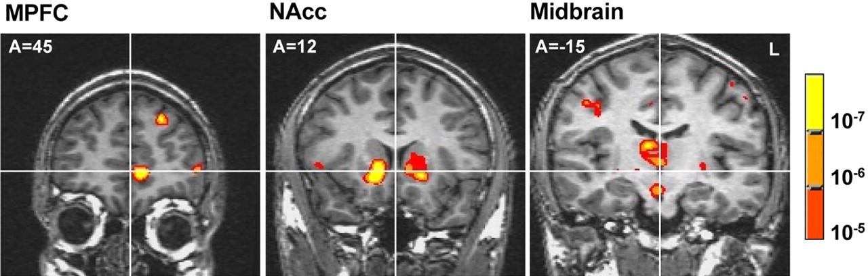
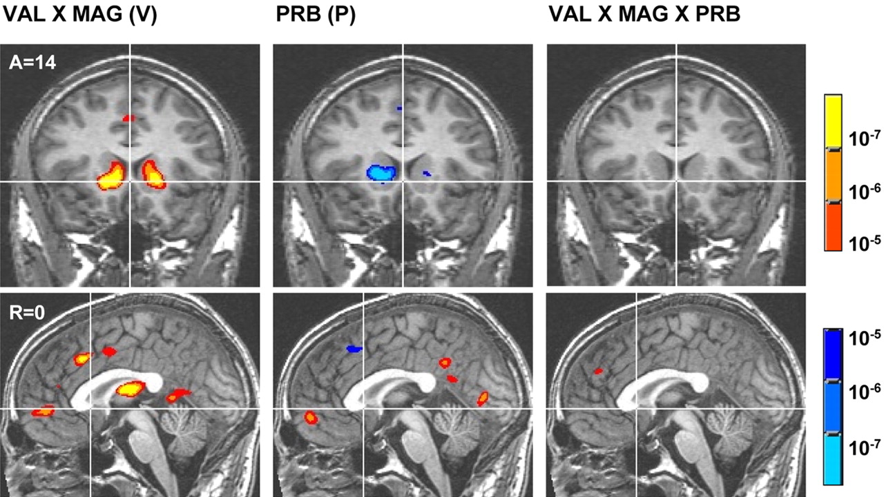
Monetary Gains & Losses
Expected
Value
Component
Interactions
Knutson et al.
J Neurosci 2007

Slide 31
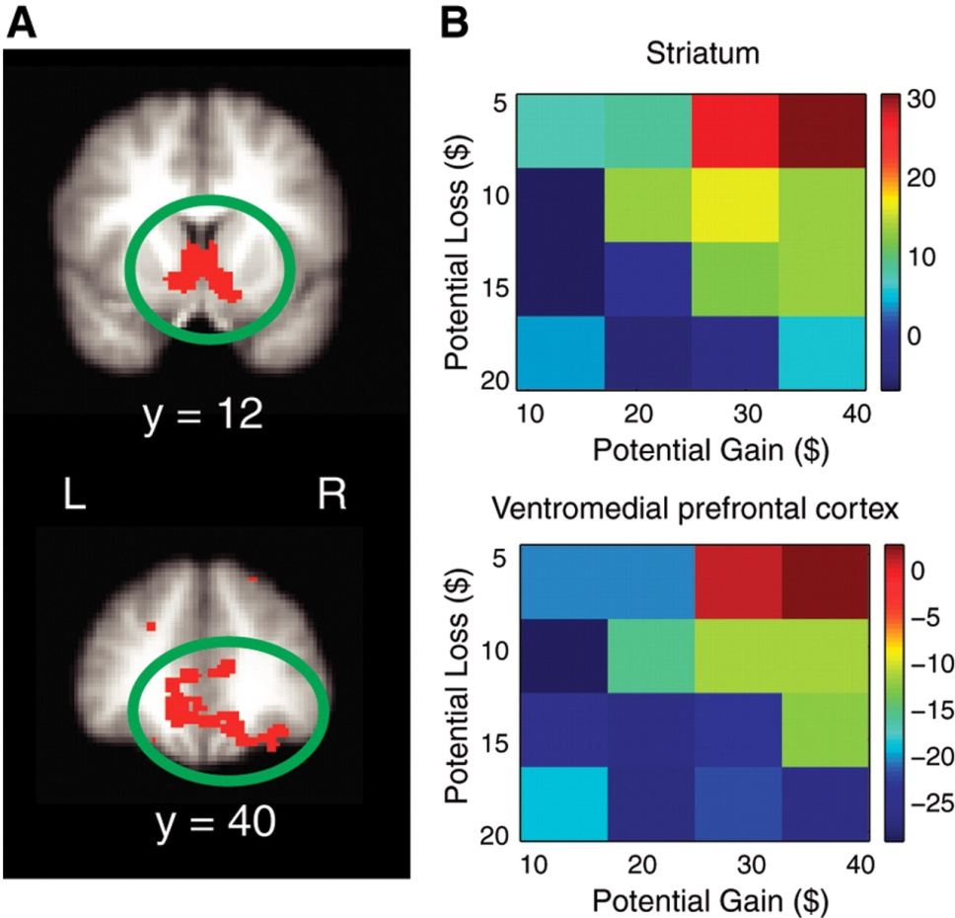
Loss Aversion
Tom et al., Science 2007

Slide 32
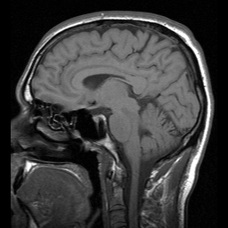
Valuation Circuit
Value (reward, value, etc)
Expected Value

Slide 33
Summary & Future Work
OFC – striatal system as a common neural currency metric
Losses (bads) are relatively unexplored
Differences between experienced vs decision utility

